Slide 1

SERIES A INVESTMENT OPPORTUNITY
VECTOR RIDGE
The Future of Engineered Regional Apparel
Technical Precision Meets Texas Terrain

Slide 2
THE VISION
TECHNICAL PRECISION
MEETS TEXAS TERRAIN
Bridging 25 years of IT excellence with the rugged beauty of the Hill Country to redefine regional lifestyle gear.

Slide 3

MARKET OPPORTUNITY
THE PROBLEM
THE SOLUTION
THE CLICHÉ GAP
ENGINEERED APPAREL
Regional apparel in Texas is saturated with generic tourist motifs and overused slogans. Existing brands lack the technical sophistication and premium quality required by the modern, affluent professional class.
Vector Ridge offers "Technically Designed" clothing. We blend software-inspired precision, billiards-culture geometry, and high-end functional fabrics for a discerning audience in the Hill Country and beyond.

Slide 4

PRODUCT FOCUS I
THE TECHNICAL TEE
Our flagship shirts utilize Soft-Hand screen printing and DTG technology to render complex topographic and blueprint designs. Targeted at the $32 retail point, these garments offer 75% gross margins with high-retention aesthetic appeal.
•
Topographic Balcones Fault Series
•
Blueprint Billiards Technicals
•
Binary Flora Collection

Slide 5




PREMIUM OUTERWEAR
PRODUCT FOCUS II
THE HORIZON HOODIE
Engineered with 400gsm heavyweight fleece and high-density 3D embroidery. This line is designed for the software peer group—subtle, tonal branding that functions in both a professional office and the Austin night air.

Slide 6




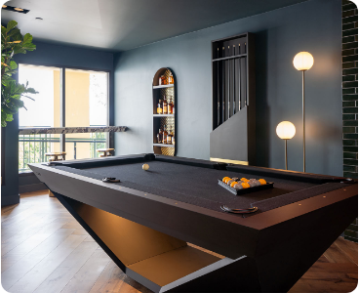
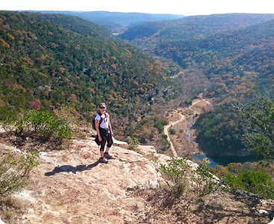
LIFESTYLE & PERFORMANCE
LAKE LIFE
THE RAIL
TOPO HIKE
Sublimated 5" trunks.
Casual cotton blends.
Ripstop 7" technicals.

Slide 7
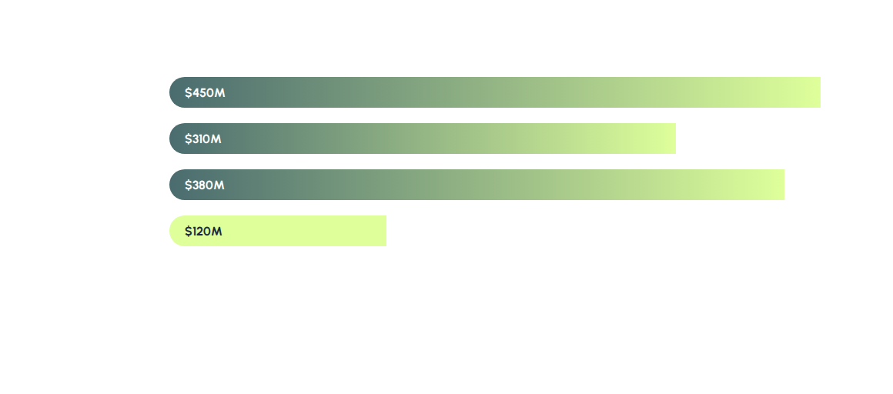
MARKET DOMINANCE STRATEGY
"Capturing the tech-centric, high-disposable income demographic of Central Texas."

Slide 8
PROVEN TRACTION
EFFICIENCY IN SCALE
64%
Our "Seed" phase utilized DTC (Direct-to-Consumer) and local Austin markets to validate designs. The result is a hyper-loyal community that prioritizes the "Technical & Terrain" aesthetic over generic alternatives.
Repeat Customer Rate
CAC
$12.40
LTV
$185.00

Slide 9


FOUNDER & VISIONARY
PRECISION SOFTWARE MEETS CREATIVE DESIGN
Bringing **25 years of Software & IT Leadership** to the apparel world. Our founder treats product development like a software sprint: rapid prototyping, data-driven design, and absolute precision in execution.
A lifelong resident of Cedar Park and Hill Country enthusiast, blending passion for hiking, travel, and competitive billiards into a unique brand identity.

Slide 10
24-MONTH ROADMAP
Q1 2026
Q3 2026
Q1 2027
Q4 2027
AUSTIN ALPHA
THE GULF PUSH
TECH HUB SCALE
GLOBAL RIDGE
Launch flaghip Cedar Park/ATX retail partner presence.
Expansion into Gulf Coast & Houston markets.
Custom corporate line for major TX tech firms.
International e-comm shipping & global travel series.

Slide 11
INVESTMENT SUMMARY
SEEKING $1.5M SEED ROUND
Use of Funds | Allocation (%) | Primary Objective
Inventory & Production | 45% | Scale to 10k units/month capacity.
Marketing & Growth | 30% | DTC Performance ads & Influencer network.
Talent Acquisition | 15% | In-house design & ops team.
R&D (Smart Fabrics) | 10% | Developing tech-integrated garments.

Slide 12

READY FOR THE RIDGE?
Join us in engineering the next icon of Texas apparel.
INVEST@VECTORRIDGE.COM
AUSTIN | CEDAR PARK | HILL COUNTRY

Slide 13






IMAGE SOURCES
https://assets.thenorthface.eu/images/t_img/f_auto,h_462,e_sharpen:60,w_462/dpr_2.0/v1722850907/NF0A89DR1I4-ALT1/Mens-LongSleeve-Topographic-TShirt.jpg
Source: www.thenorthface.com
https://kinapparel.org/cdn/shop/files/13_14_7822fbdb-d373-44fc-9a93-b179f9ba874f.png?v=1765039101
Source: kinapparel.org
https://urbanoasiscontracting.com/wp-content/uploads/2025/08/austin-farmers-market-stalls-198.webp
Source: urbanoasiscontracting.com
https://dxt1dc7xo1tv8.cloudfront.net/2023/03/0000_DSC08622.jpg
Source: www.sawyertwain.com
https://thegoldenhouradventurer.com/wp-content/uploads/2019/04/Lost-Maples5a.jpg
Source: thegoldenhouradventurer.com
https://images.scalebranding.com/0144dcd2-02d8-48fc-89e6-9e8c6bd8b160.png
Source: scalebranding.com

